Slide 1









ABC World
Members: Francisca Cardemil and Marcelo Castillo
Company: Agustín Edwards Elementary School
Representative: Víctor Faúndez

Slide 2


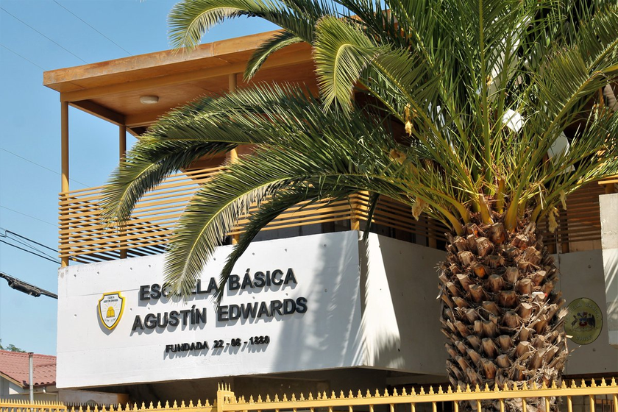

Agustín Edwards Elementary School
Issues

Slide 3


Design and implement a digital educational game that promotes reading and letter recognition in children aged 4 to 6 at the Agustín Edwards elementary school.
General objective

Slide 4






Specific objectives
Develop interactive and playful activities that allow children to identify and recognize the letters of the alphabet in an entertaining way.
Integrate progressive levels of difficulty, starting with letter recognition and moving on to the formation of syllables and simple words.

Slide 5

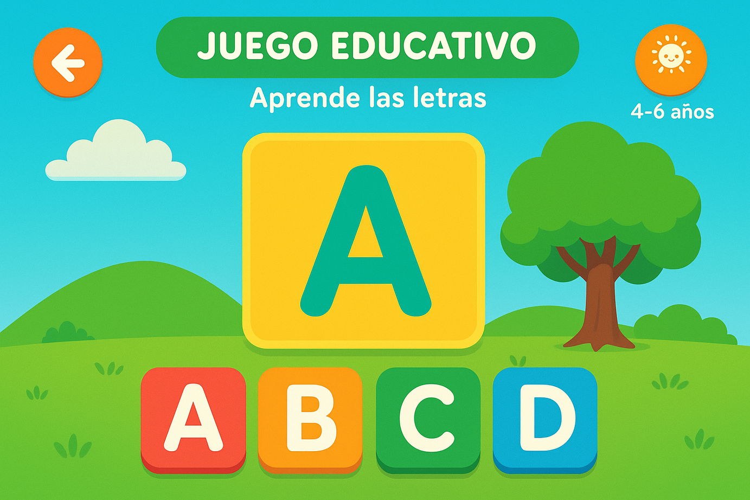

Solution

Slide 6











Methodology

Slide 7








Technologies
HTML, CSS, and JavaScript

Slide 8

Firebase
To save children's progress, usage statistics, or completed levels

Slide 9

Node.js
For managing server logic, APIs, and data storage

Slide 10

Bootstrap
For simplicity and speed in responsive game design

Slide 11

Expected results and analysis
No
KPI
Goal
1 | % improvement in letter recognition | At least a 30% improvement in students who use the game.
2 | Average interaction time per session | Between 10 and 15 minutes per child, enough to maintain interest without causing fatigue.
3 | Children's motivation index | 80% of children show motivation during activities.

Slide 12


Thank you for your attention.

